Slide 1
Computer Science for All Through Inclusive Design
Hosted by the DIAGRAM Center
March 15, 2017

Slide 2


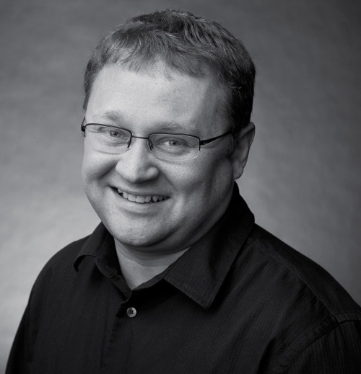
Today’s Presenters
Richard Ladner
University Of Washington
Sina Bahram
Prime Access Consulting
Andreas Stefik
University of Nevada, Las Vegas

Slide 3
Computer Science For All Initiative
In the coming years, we should build on that progress, by … offering every student the hands-on computer science and math classes that make them job-ready on day one.
  President Obama in his 2016 State of the Union Address

Slide 4
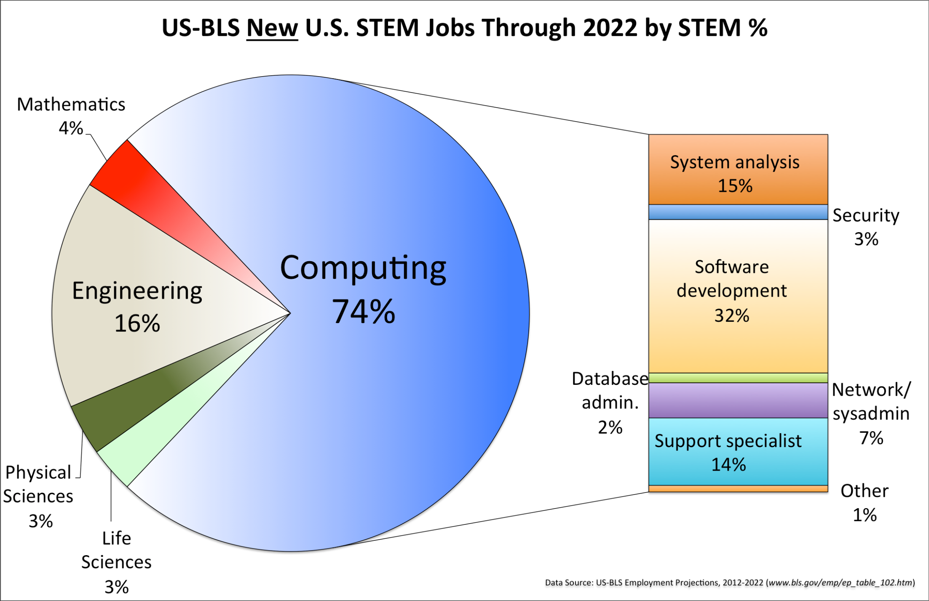
STEM Career Outlook

Slide 5




Major Efforts
Exploring Computer Science
AP Computer Science Principles
AP Computer Science A
Bootstrap

Slide 6

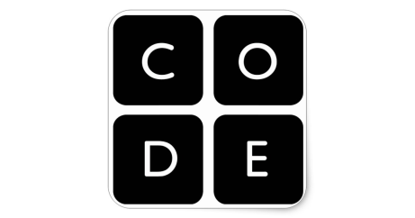

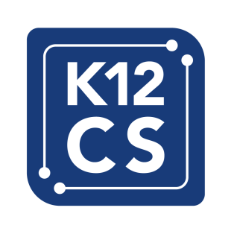
Major Organizations
National Science Foundation
Code.org
Computer Science Teachers Association
K-12 Computer Science Framework

Slide 7




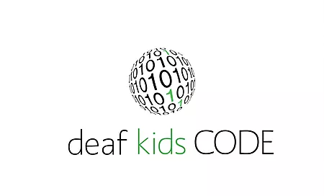
CSforAll Consortium (220 Members)
AccessCSforAll
Bringing AP CSP to Students with Learning Differences
Deaf Kids Code

Slide 8


0
Founded 2014
Founded 2014
Richard E. Ladner, PI
Andreas Stefik, PI
Sheryl Burgstahler, Co-PI and Director
Notes:
I will be telling you about AccessComputing, the alliance for access to computing careers.
Before I start I want to let you know that I have found it challenging to make an accessible talk in the flash format described in the NCWIT speaker tips. Since some people in the room may be deaf or blind, I’ll try to make the talk more accessible to them.
For those who are deaf, when new information comes on a slide, I will pause to let them read the slide before looking at the interpreter or real-time captioning.
For those who are blind I will describe as many of the pictures as I can.
Let’s give it a try.

Slide 9
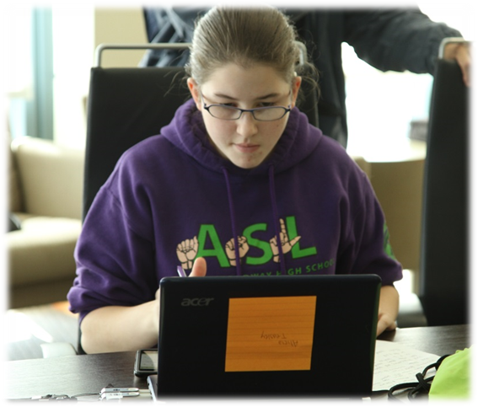
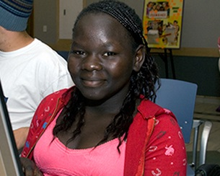
AccessCSforAll Goal
Increase the participation and success of students with disabilities in K-12 Computer Science
Notes:
What is the Goal of AccessComputing.
Simply put it is to increase the participation and success of students with disabilities in computing field.
In the three pictures we show:
Two blind computer scientists accessing a computer with a screen reader that allow they to read and navigate a computer screen.
A deaf student learning to program in Scratch.
A student with a mobility disability using an enlarged keyboard to access a computer.

Slide 10
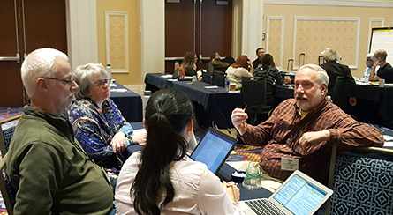



AccessCSforAll Strategies
Capacity Building
Tool and Curriculum Development
Notes:
We have two basic strategies to achieve our goals.
First, direct interventions, like the one shown in the picture of me with 15 blind children learning computer science concepts via accessible Computer Science Unplugged activities.
Second, institutional change, helping computing departments, organization, and conferences be more welcoming and accessible to people with disabilities. The picture show a prominent building at the University of Maryland.

Slide 11
Things to Consider When Thinking About Programming and Accessibility
Existing solutions for different user groups
What are the problem areas?
Incorporating inclusive design into programming technologies

Slide 12
Existing Solutions for Different User Groups
Blind:
  Use of screenreaders
    Sometimes accompanied by a braille display (however, speed is a factor)
Low vision:
  Text enlargement/zoom
Physical impairment:
  Sticky keys, one-handed keyboards, eye-tracking, voice-based programming

Slide 13
Problems with Existing Accessible Solutions
Many bespoke solutions
Awareness of existing solutions is low
Educational resources and those on the web are not necessarily accessible
Mainly it’s power users that end up succeeding
Even when things work, they aren’t great
  for(int i=0; i<10; i++) {
  for, left paren, int i equals zero, semicolon, i less than 10, semicolon, i plus plus, right paren, open brace

Slide 14
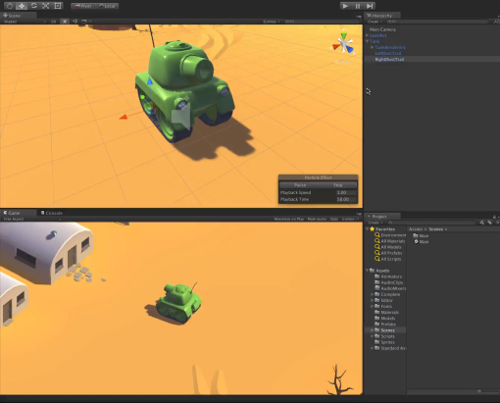
Problems with Current Inaccessible Solutions
Programming environments are complex (most rely upon the use of an integrated development environment [IDE])

Slide 15
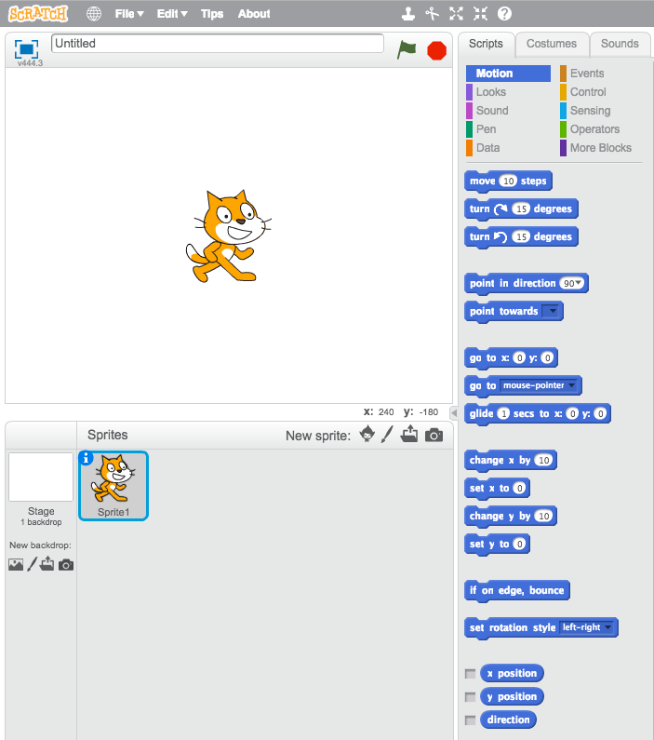
Problems with Current Inaccessible Solutions
Block-level languages

Slide 16
How We Can Make Things Better
Weaving inclusive design into programming technologies themselves
This is not only a tooling problem but the inputs, outputs, and the surrounding educational and professional resources need to be born accessible

Slide 17
Why Does This Matter?
Persons with disabilities need to be part of the solution creation process, not just recipients of benevolent works
By facilitating access to computer science education, students with disabilities are given the tools they need to create the assistive technologies of the future
Institutional inertia matters a lot! We can easily lose an entire generation’s representation in computer science if we don’t find solutions to these problems

Slide 18
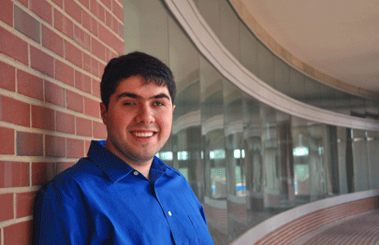
Quorum Started in 2009 as a Language for the Blind
Until 2012, the language was used exclusively by this community
As Quorum was born accessible, we conducted extensive testing with this user community
Under an NSF grant, CNS-0940521, many schools for the blind started teaching Quorum
Sina Bahram
White House Champion of Change
Prime Access Consulting
https://pac.bz/

Slide 19
Quorum and all supporting materials are free for all
On Quorum, we have available:
  The language itself (BSD Software License)
  A Standard Library (BSD Software License)
  Tutorials and Documentation (Creative Commons)
  Lessons for students to learn (Creative Commons)
Materials are vetted by a curriculum committee of professional teachers with expertise in education and accessibility
Curriculum follows a series of tracks in gaming, LEGO robots, and a variety of other computer science topics

Slide 20
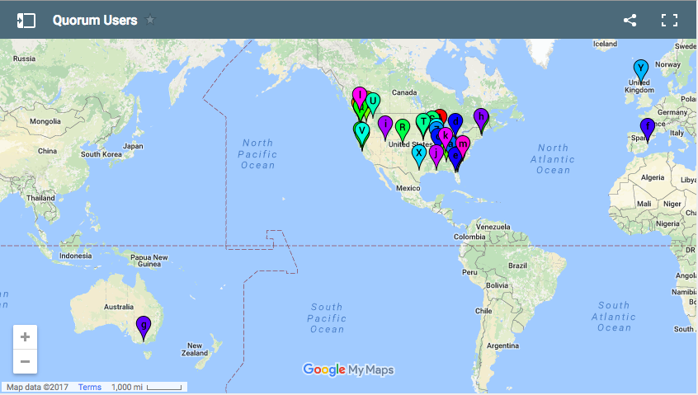
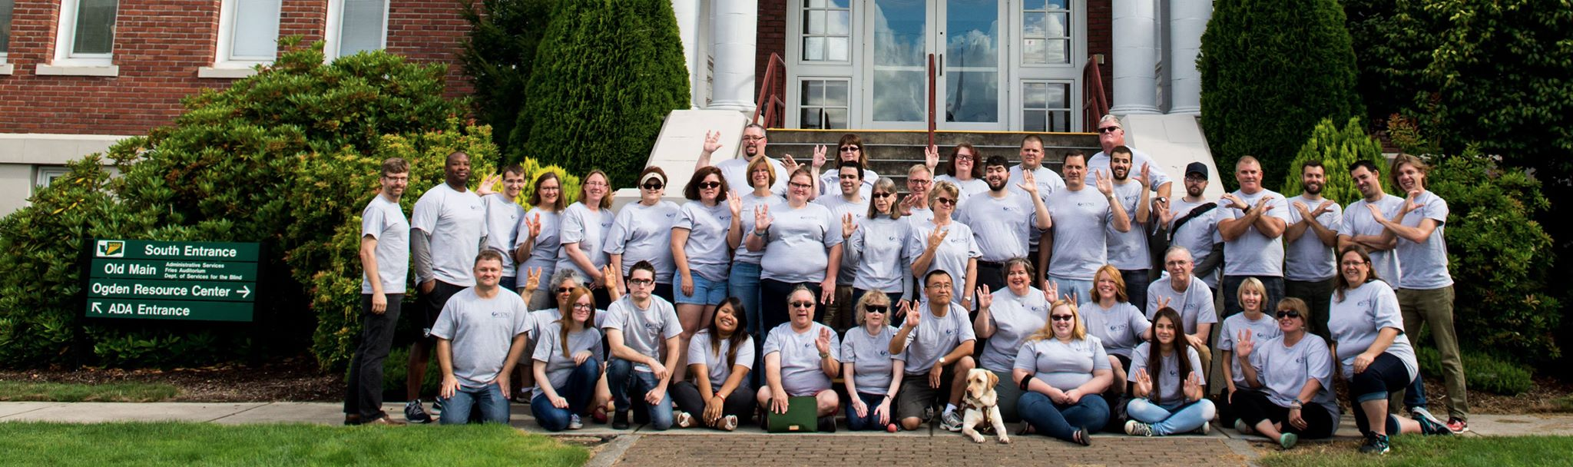
Experience Programming in Quorum (EPIQ) Appeared
By 2016, about half of the schools using Quorum are in general education – about 2,500 students
Quorum expanded significantly
  Extensive multimedia libraries
  Extensive teacher created documentation was developed
  Easy text-to-speech with the “say” command
EPIQ 2015

Slide 21
What does Quorum Support in Practice?
Extensive Multimedia libraries
  We support 2D and 3D game multimedia designs (sound + graphics)
  Extensive technical backend (e.g., openGL, openAL, hardware acceleration)
  Embedded Physics (Quorum 5)
Multi-Platform Support
  Windows and Mac OS X
  Run in a Browser, including games, in Quorum 5 (June)
  Can compile to iPhone in Quorum 4 (Android in Quorum 6 - 2018)
Extensive Additional Support
  Libraries for music, LEGO (accessibly), math, and many other features
  Support in NetBeans, on the web, and in the console
Key Point:
Quorum provides extensive commercial strength and powerful support, but is extensively vetted for ease of using precise and replicable methods.
Quorum is likely not for the very young (e.g., those that cannot read), but is used extensively by middle and high school students, including those with disabilities.

Slide 22
In Quorum, we try to make hard things easier
Consider an example: writing a 3D audio system
One way we might do that is to use a library called OpenAL in C++
Some features of OpenAL include:
  3D positional audio
  Distance attenuation
  Simulation of Doppler Effect
As many features in Quorum are very advanced, they are generally not available in educational tools (e.g., Scratch)

Slide 23
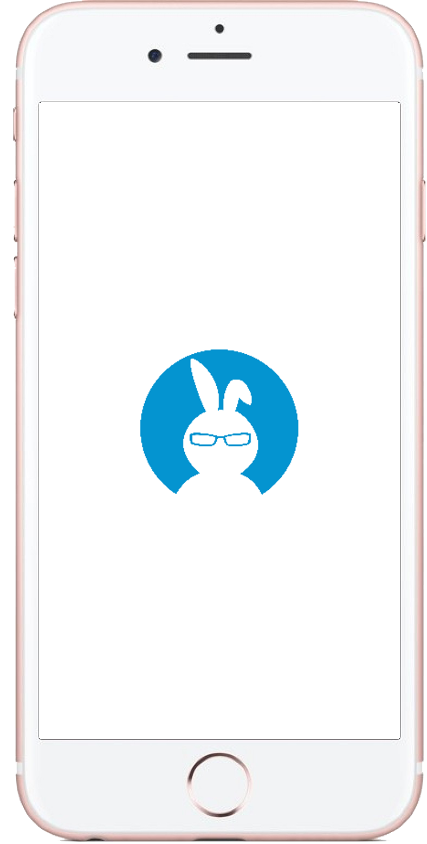
Loading and Using Sounds in OpenAL/C++ is Hard
alListenerfv(AL_POSITION, listenerPosition);
alListenerfv(AL_VELOCITY, listenerVelocity);
alListenerfv(AL_ORIENTATION, listenerOrientation);
alutLoadWAVFile(”MySound.wav", &format, &data, &size, &frequency, &loop);
alGenBuffers(NUM_BUFFERS, buffer);
alBufferData(buffer[0], format, data, size, frequency);
alGenSources(NUM_SOURCES, source);
alSourcefv(source[0], AL_POSITION, source0Position);
alSourcefv(source[0], AL_VELOCITY, source0Velocity);
alSourcefv(source[0], AL_ORIENTATION, source0Orientation);
alSourcei(source[0], AL_BUFFER, buffer[0]);
alSourcePlay(source[0]);
Understanding OpenAL requires knowledge of Linear Algebra
Naming conventions make very little sense
Moving to other platforms is a considerable amount of work

Slide 24
Quorum does the same thing, but removes complexity where possible
Imagine making a sound source in 3D space with Quorum
The code on the right:
  Loads a sound file
  Prepares the sound for looping
  Sets a sound’s position in 3D space
  Plays the sound
use Libraries.Sound.Audio
Audio birds
birds:Load(“Birds.wav”)
birds:EnableLooping()
birds:SetPosition(0.6, 0.9, -0.2)
birds:Play()

Slide 25
We use the Scientific Method for Improving Usability
Trying to improve usability for blind programmers brought up nagging questions
Innocently, we tried to look up all the human factors data on languages
Except, we found something … unexpected
The Programming Language Community
was not gathering evidence
Proofs? ✔
Performance Data? ✔
Human Factors Data? ✖
Quick Detour on the history of evidence gathering regarding human subjects.

Slide 26
A Quick Primer on the History of Evidence Gathering on Humans
For more information, consider reading:
Kaptchuk, Ted. Intentional Ignorance: A History of Blind Assessment and Placebo Controls in Medicine. Bulletin of the History of Medicine, 72.3 (1998) 389 – 433.
http://media.virbcdn.com/files/5f/FileItem-260254-Kaptchuk_IntentIgnor_BulHisMed1998.pdf
And the book on the right --------→

Slide 27
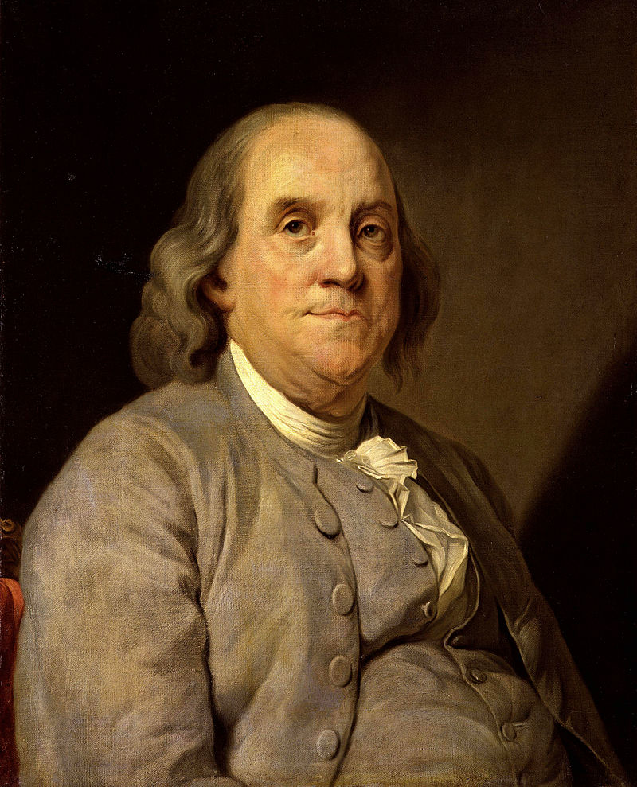
Human Factors Experiments Detect Quackery and Fraud*
Louis the XVI formed a commission to evaluate Mesmerism (animal magnetism):
  Whether the methods analyzed had “real” force
  Explicitly excluded “non-physical” arguments
  Led by Benjamin Franklin
How do we know if it is a real “force?” Use sham treatments
Scientists already had the answer, yet the medical community debated whether the “experiments were good enough” for nearly a century
* Quackery means an individual believes something thoroughly refuted by the evidence. Fraud means intentional distortion of the facts.

Slide 28
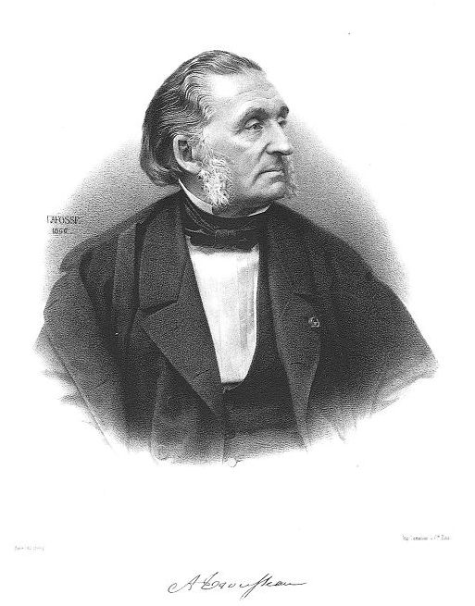
The Nuremburg salt test of 1835 Evaluated “Homeopathy”
Friedrich Wilhelm von Hoven, a doctor in the period, considered the technique to be dangerous and probably fraud
The salt test was very close to a modern randomized controlled trial (without stats)
Many other investigations have taken place, including early ones like:
  Armand Trousseau (1801 - 1867) and his students using bread pills (Placebo, 1834, negative result)
  Other double blind trials in 1879-80 (Milwaukee Academy of Medicine – inconclusive result)

Slide 29
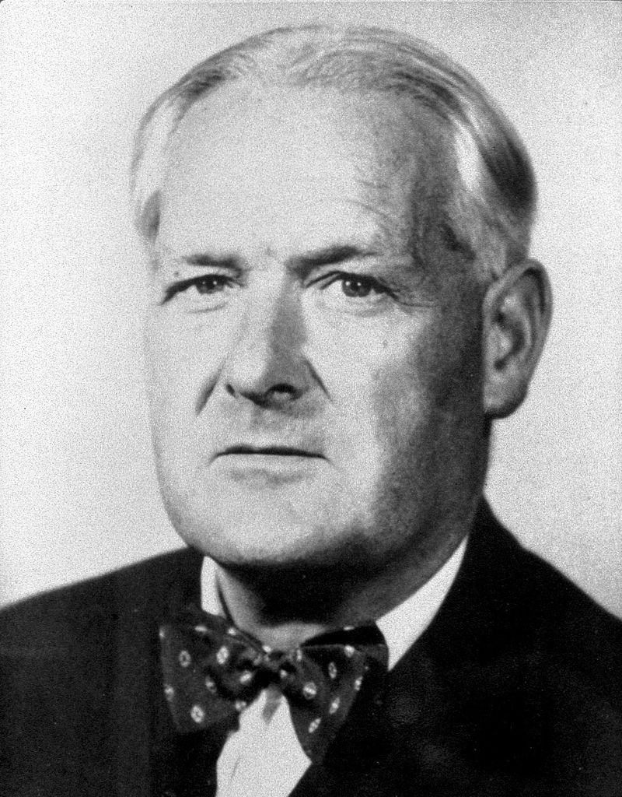
Bradford-Hill’s Precision and Coherence were Seminal
By 1935, Fisher coined his famous work, “the Design of Experiments.”
  Randomization was controversial at the time
  Journal of AMA wrote in 1955, that treatments should be “[kept] in the hands of the general practitioner and not … [be] on the basis of experiments” (corrections Kaptchuk’s)
  By the 1940’s, the veterans administration began using Fisher’s ideas more formally
The first actual randomized controlled trial was done by Austin Bradford Hill (1897 – 1991)
  Bradford-Hill caused a paradigm shift in his field, with the number of RCTs increasing by approximately 11.2%/year since in it (110,485 between 1990 – 2001)
  By the mid-1990s, and today, this has culminated into the CONSORT standard of evidence

Slide 30
Key Observation:
Scientists over time have increased their evidence standards to avoid bias, fraud, and other issues, settling on Randomized Controlled Trials as the gold standard.
These studies, along with field work, provides us more precise methods and helps us identify quackery and fraud.

Slide 31
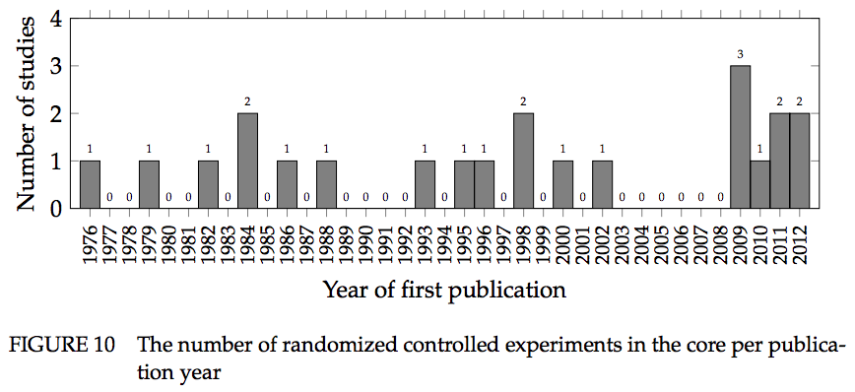
There was (nearly) no evidence – language designers were using anecdotes
Only 22 Randomized controls trials … from the 1950’s to 2012!
Kaijanaho, A.-J., Evidence-Based Programming Language Design: A Philosophical and Methodological Exploration. PhD Diss., Information Technology Faculty, University of Jyväskylä, 2015, Jyväskylä, Finland. 222.

Slide 32
So we* created Evidence-Oriented Programming
This new paradigm has several unique attributes:
  Design features of a language must have corresponding evidence from appropriately constructed Randomized Controlled Trials
  The language authors must allow the external community to suggest changes according to the scientific method, inspired by lessons from history
  Evidence from other techniques (e.g., software repository mining, educational data) if gathered from humans and rigorous is allowed
Quorum has fixed development and evidence gathering schedules
*By “we” I especially include Stefan Hanenberg (A German scholar that independently came to the same conclusions at the same time).

Slide 33
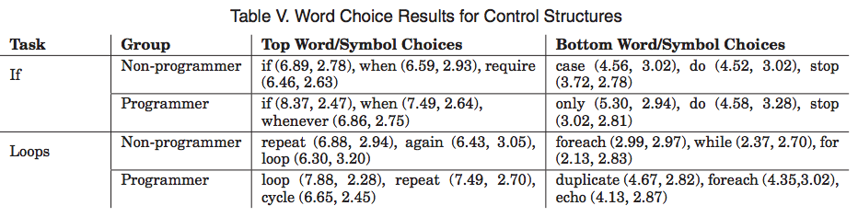
Let’s discuss how we choose our syntax/semantics
Approach: Start with surveys to get a big picture view of the alternative choices in the language.
Core Syntax and Semantics is always surveyed before going into Quorum.
Writing a program with a loop in Java vs. Quorum:
for (int i = 0; i < 10; i++) {
System.out.println(“Hello, World”);
}
repeat 10 times
output “Hello, World”
end

Slide 34
Knowing the history, we sometimes use Sham Treatments
We extensively observe people programming
  Use sham treatments (placebo languages)
  Test people across the spectrum (e.g., young, old, experienced, novice)
Use a statistical procedure to determine which tokens or combinations of tokens cause an impact
This is called “Token Accuracy Mapping”
The technique comes from reading DNA sequences
Result: Novices can use the programming languages Java and Perl no better than a language generated randomly from the ASCII table.
Sham treatments and randomized controlled trials provide us a way to precisely evaluate observations, as historical lessons say should be the case.

Slide 35
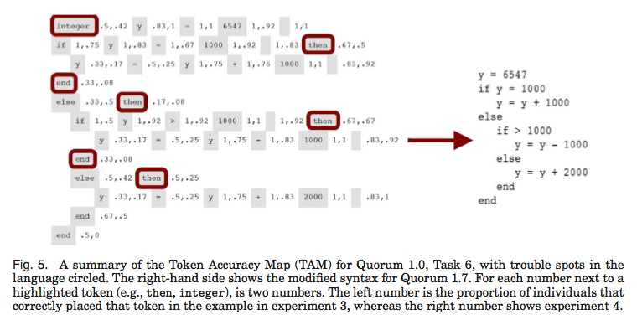
Token Accuracy Maps Provide Clues about Syntax Design*
Token Accuracy Maps tell us which tokens cause problems
* This does not just mean novices: Programmers' Build Errors: A Case Study (at Google) Hyunmin Seo, Caitlin Sadowski, Sebastian Elbaum, Edward Aftandilian, and Robert Bowdidge, Hong Kong University of Science and Technology, China; Google, USA; University of Nebraska-Lincoln, USA, ICSE 2014

Slide 36
Let’s look at an “action” in Quorum
Needs More Research
Assignment not allowed. RCTs suggest this matters
action GetClassesSortedInPackage(text packageKey) returns Array<Class>
HashTable<text, Class> pack = packages:GetValue(packageKey)
if pack = undefined
return undefined
end
Array<Class> sorted
Iterator<Class> cl = pack:GetValueIterator()
repeat while cl:HasNext()
Class next = cl:Next()
sorted:Add(next)
end
sorted:Sort()
return sorted
end
We allow limited Generics,
guided by Hanenberg
and Parnin’s research
PascalCase, not
Under_Score
Bind points need types,
but some inference on the
inside of actions is allowed.
No one knows how much
inference should be allowed
Use words/symbols
derived from surveys/TAMs

Slide 37

Getting involved:
  Join the Quorum Mailing List: https://groups.google.com/forum/#!forum/quorum-language
  Post on the Quorum Facebook page: https://www.facebook.com/quorumlanguage
  Write a game and post it on Github or Bitbucket
  Use Quorum for a computer science course
  Gather precise evidence and help improve language designs for everyone
Please feel free to get in touch on build games, tell us what you think, or help us make things better!
If you are interested in language designs based on evidence, check out the Quorum project:
www.quorumlanguage.com

Slide 38
Thank you for Listening!

